Slide 1
Install & Use Terraform on AWS Cloud Shell
Basic Use of Terraform Commands
Joseph C Luster
02/24/2025

Slide 2
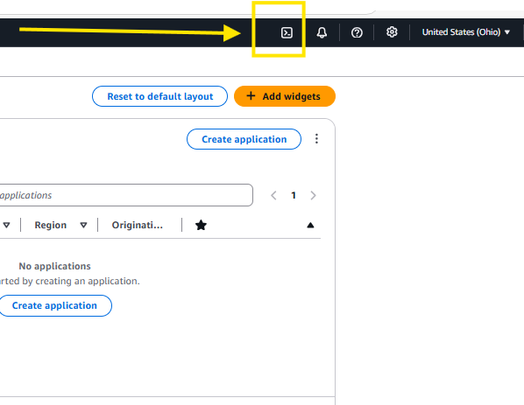
Setup AWS Credentials in Cloud Shell
1. Open Cloud Shell.
Navigate to https://console.aws.amazon.com/
Sign into your AWS account. (This tutorial assumes account and user creation have been established already.)
Click the CloudShell Icon in the top right corner of the AWS Console Home Page.
2. Configure the Cloud Shell Session With Your AWS Credentials.
Run aws configure
Paste your credentials as prompted.
NOTE: You will need access to your AWS “Access Key ID”, “Secret Access Key”, Region of Choice, and a preferred output format.
VISUAL ON NEXT SLIDE:

Slide 3
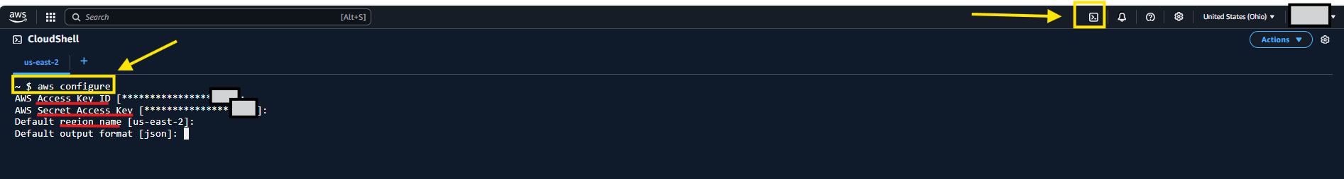
AWS Credentials In Cloud Shell Example:
1.) Cloud Shell Icon
2.) Run aws Configure Command
3.) Your User Info Goes Into These 4 Fields.

Slide 4
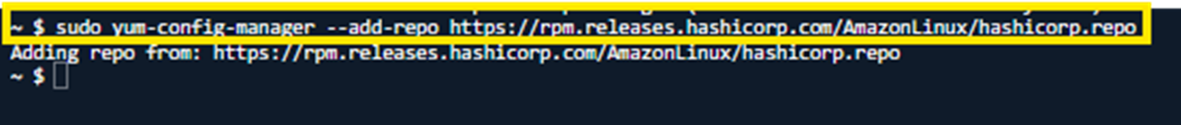
Prepare to Install Terraform
3. Install yum-utils.
~ $: sudo yum install -y yum-utils
4. Add the “HashiCorp” Repo. (Provides Latest Terraform Packages for AWS Linux.)
~ $: sudo yum-config-manager --add-repo https://rpm.releases.hashicorp.com/AmazonLinux/hashicorp.repo

Slide 5
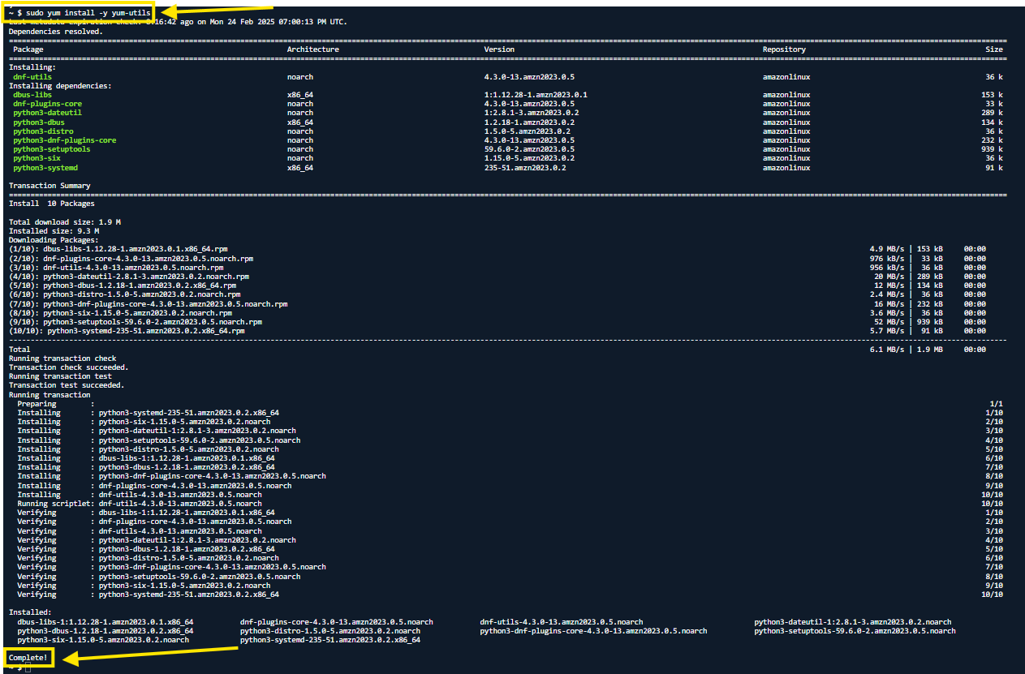
3.) sudo yum install –y yum-utils
(Same as the Previous Step 3.
Just Zoomed in.)
3a.) End of Command Output

Slide 6

4a.) Adding HashiCorp Repo (Same as the Previous Step 4. Just Zoomed in.)

Slide 7
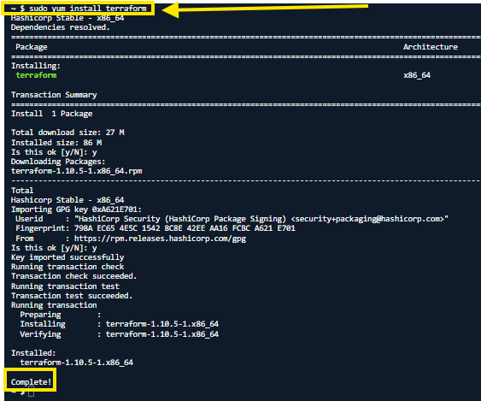
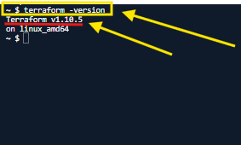
Install Terraform in Cloud Shell
5. Install Terraform:
~ $: sudo yum install -y terraform
6. Verify Terraform Installation:
- ~ $: terraform -version

Slide 8
7. Create a Directory & Upload .tf File
7a.) Create a Project Folder
- ~$: mkdir ~/tf_project1
- ~$: cd ~/tf_project1
7b.) Upload Terraform File (“example.tf”)
In Cloudshell, click Actions > Upload File > Select your .tf File
7c.) Move .tf file to your Project Folder.
- ~$: mv –f ~/example.tf ~/tf_project1
(This force moves the "example.tf" file you uploaded to cloud shell, into the file path on the right, "~/tf_project".)

Slide 9
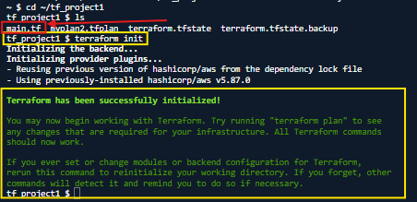
Initializing Terraform (Downloading AWS Provider Plugins and Preparing Terraform’s State:
8. Initialize Terraform:
~$: terraform init
Example.tf

Slide 10
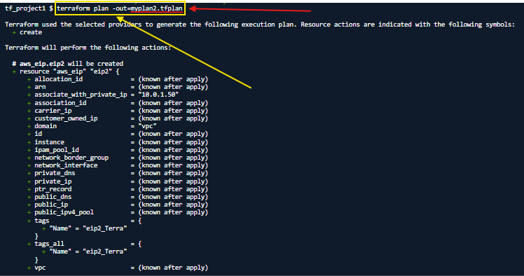
9. Create a Terraform “Plan”
9. tf_project1 $: terraform plan -out=myplan2.tfplan
Shows Potential Changes Before They’re Applied.
The –out flag saves the plan to a file. (example.tfplan)
File name that your plan will be saved as.
The Whole Command
Including your Plan’s File Name.

Slide 11
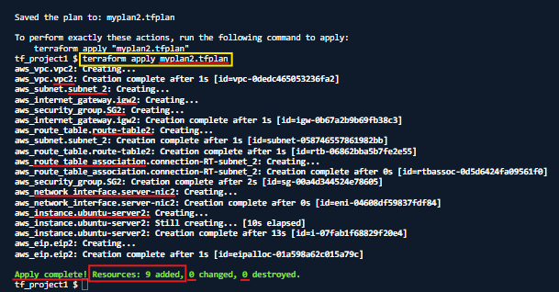
10. Deploying/Applying The Terraform Plan
10. tf_project1 $: terraform apply myplan2.tfplan
Resources Have Now Been Created!

Slide 12
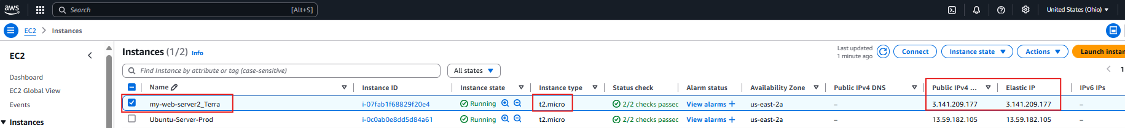
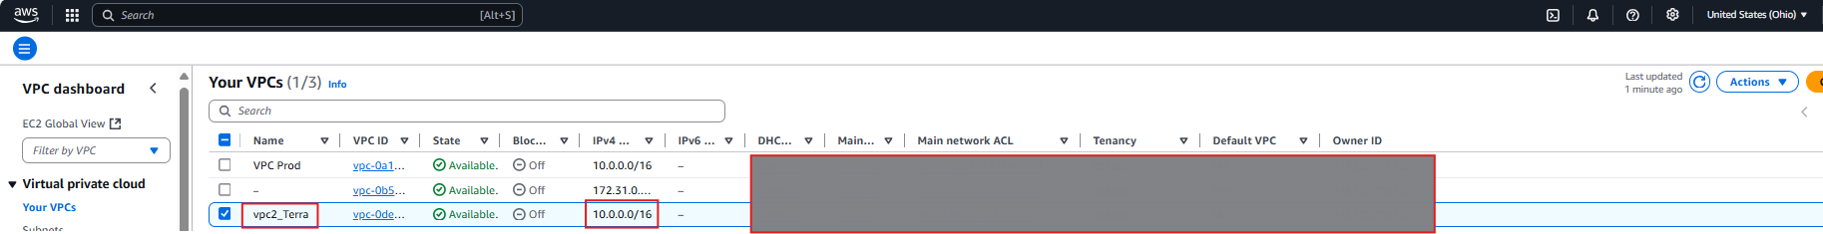
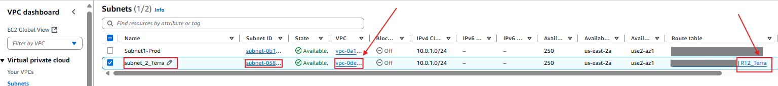
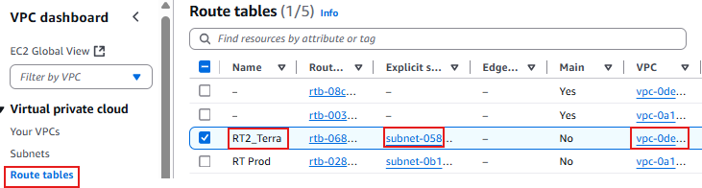
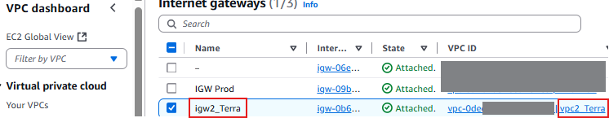
11. Verify Resource Creation Inside AWS Console:

Slide 13
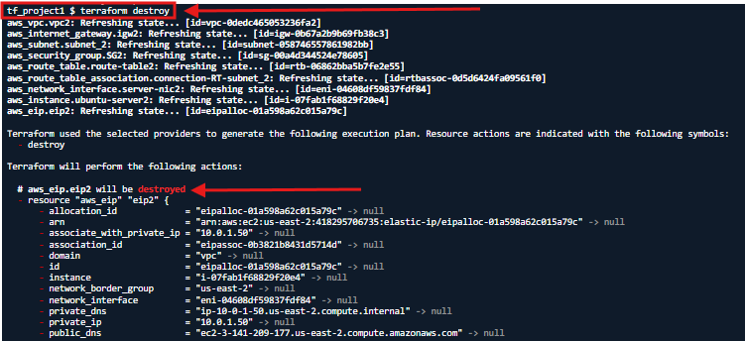
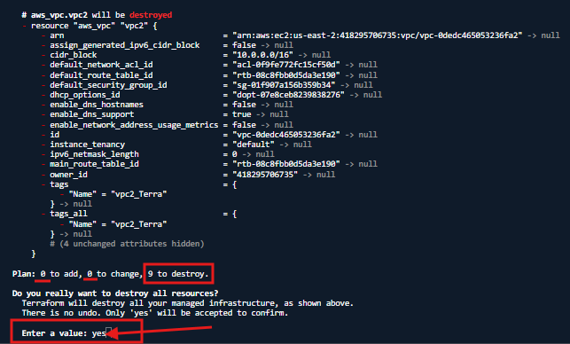
12. Destroy Everything. (If You’re Done w/The Resources.)
12. tf_project1 $: terraform destroy
(Destroys Everything You Made in that session. Be sure to confirm on Console that it was Destroyed.)

Slide 14
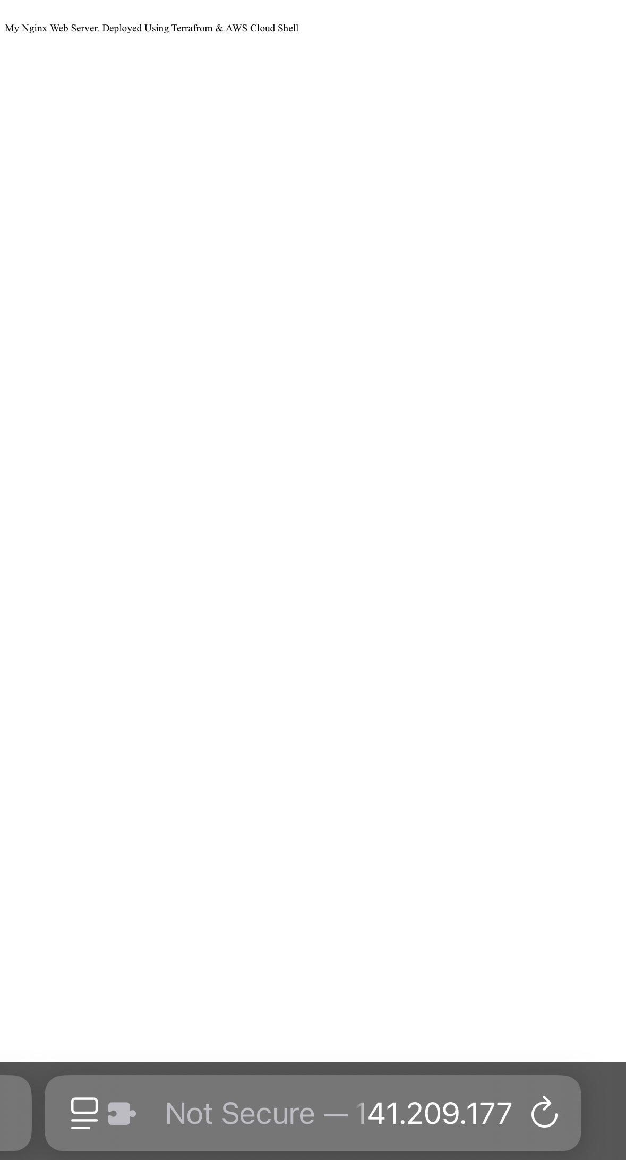
If you Haven't Destroyed Everything Yet, Confirm Your Script Worked.
MY Script Deployed an Nginx Web Server on a Linux Ubuntu EC2 Instance.
I Can Access it Using the AWS Elastic IP it Has Assigned to it. (Public & Static!)
Once I Destroy my Resources, I wont be able to.

Slide 15
Thanks for Learning!

